Slide 1
Sound Wave Inspection Systems

Slide 2
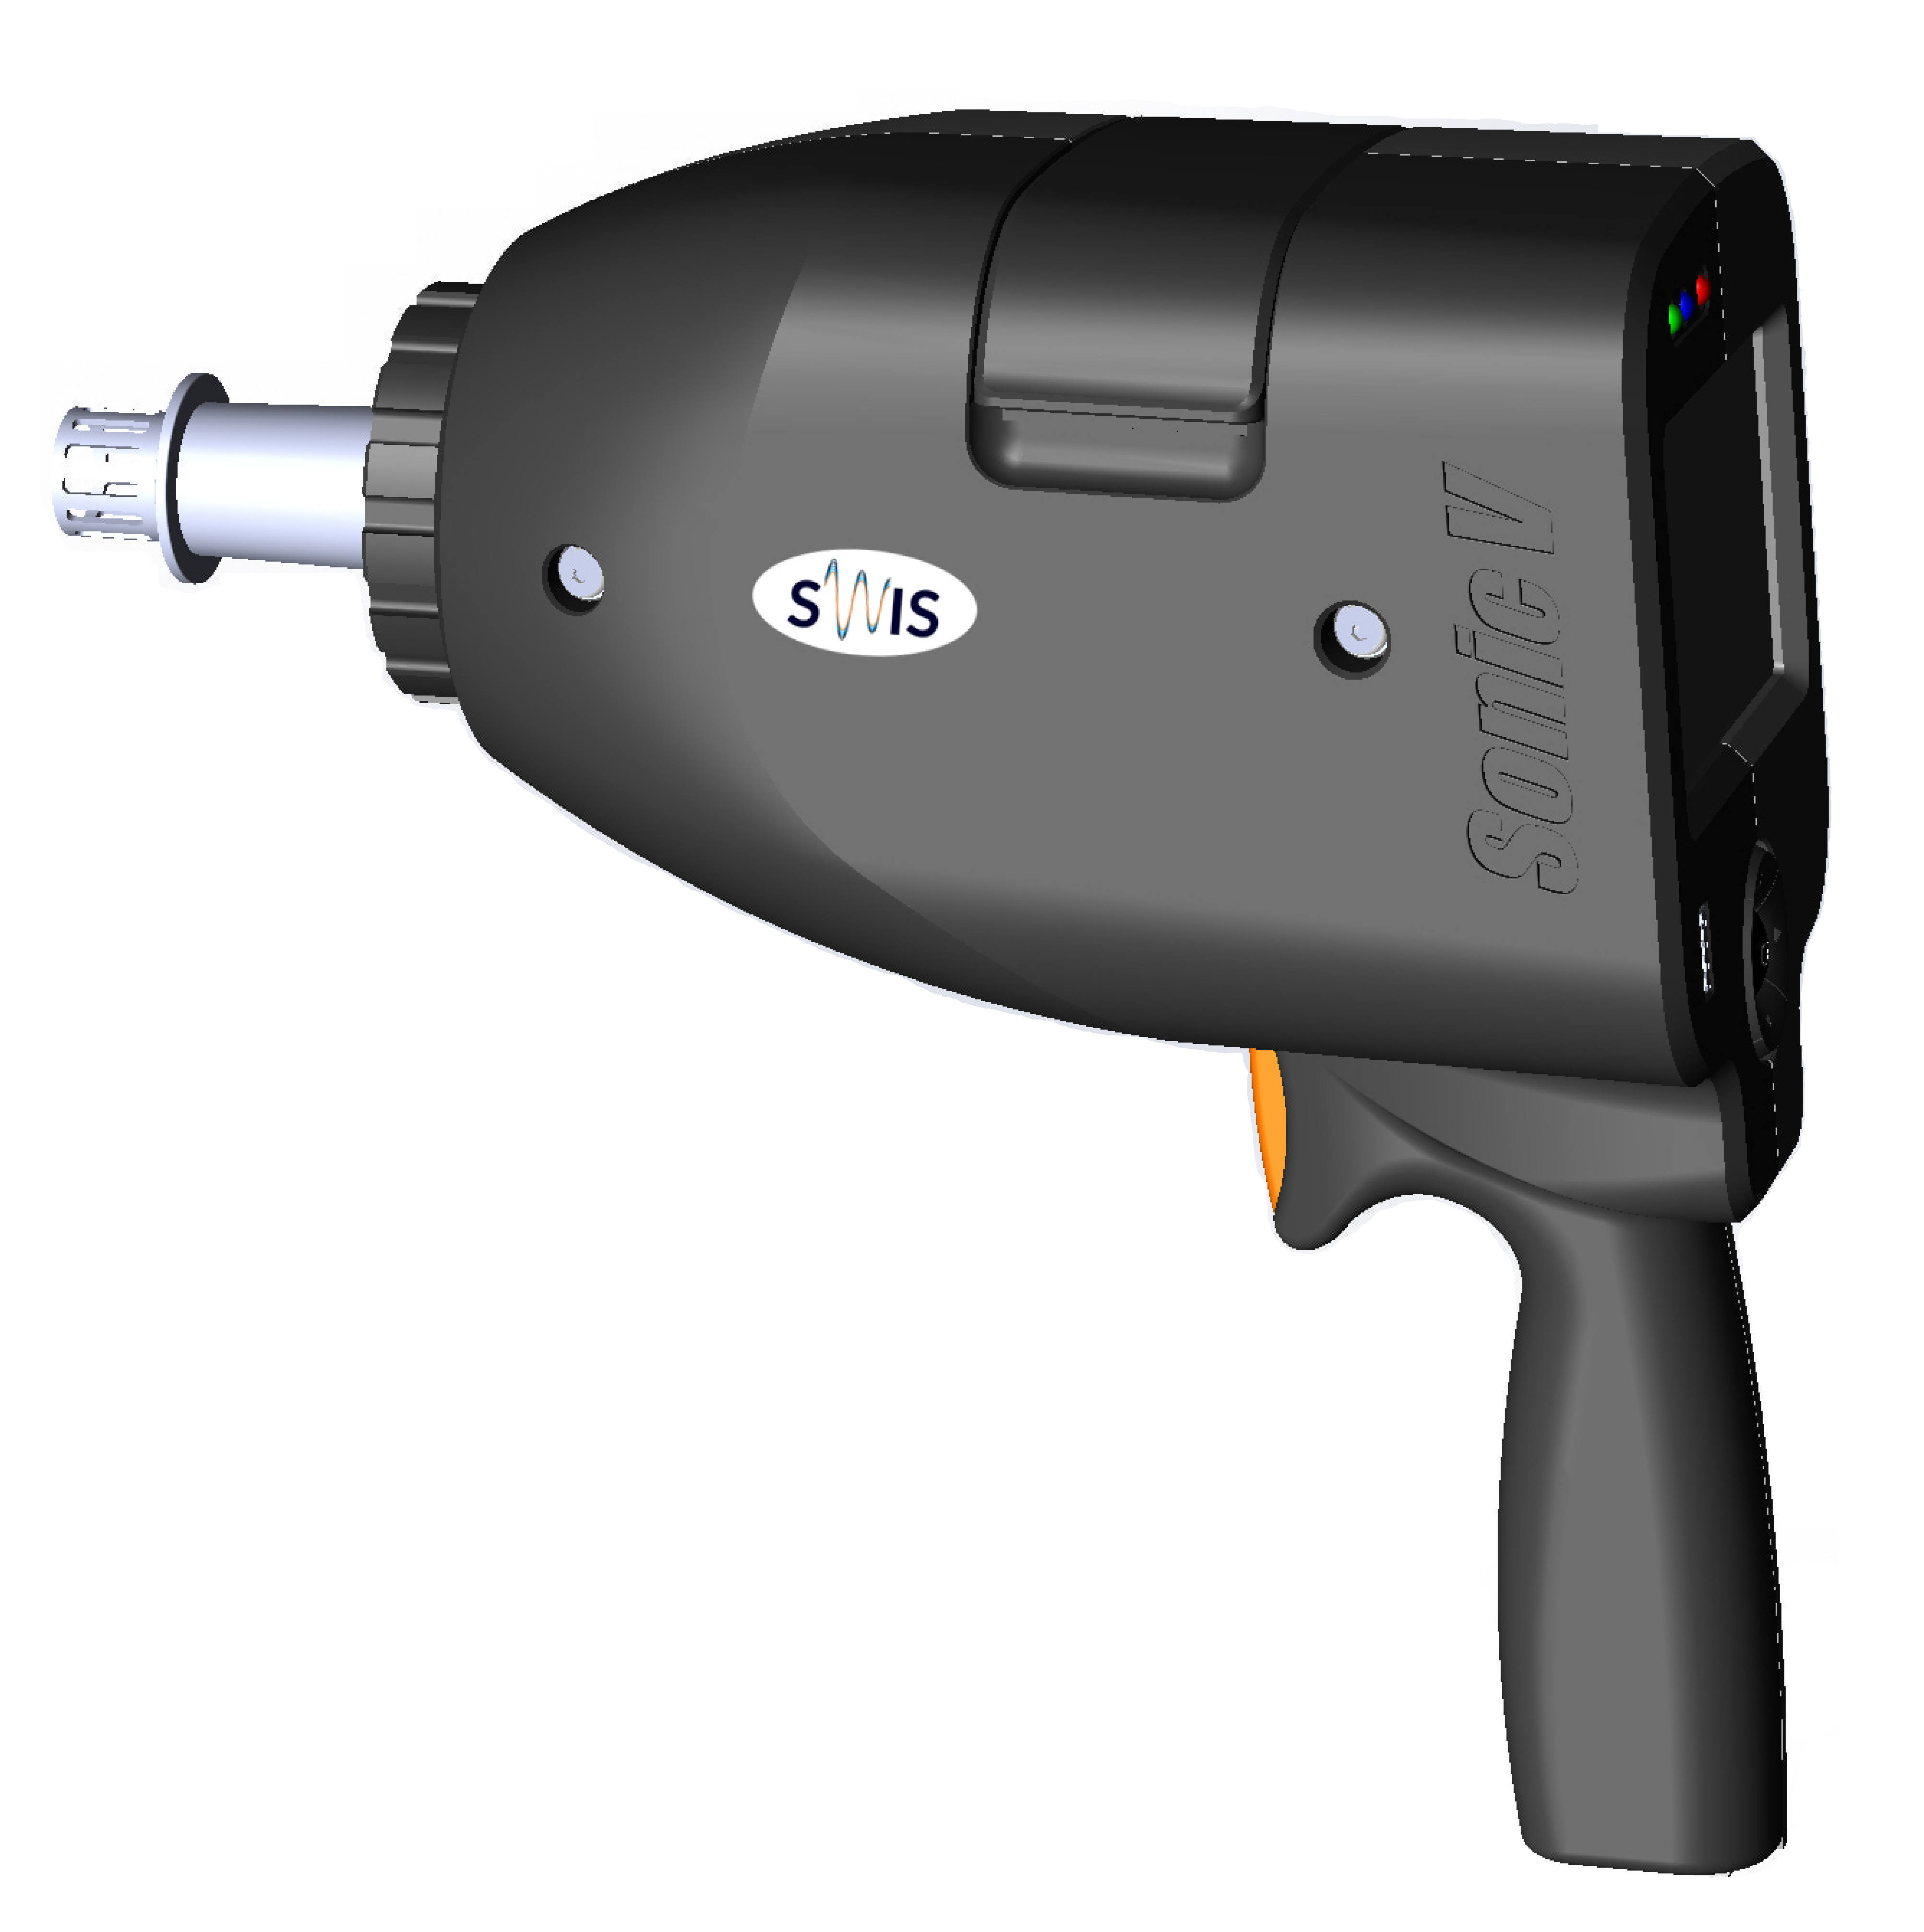
Introducing Sonic V
Fifth generation of Acoustic Pulse Reflectometry technology

Slide 3
Acoustic Pulse Reflectometry
Specially formed acoustic pulses are propagated through the air enclosed by tube
Echoes generated by defects are recorded using cutting edge microphones
Powerful algorithms are identifying location, type and size of ID defects
Acoustic pulse injected in tube
Sonic V Adaptor
Echo reflected from defect

Slide 4
APR Signals
Impulse
Reflection from a hole
Reflection from a local blockage
Reflection from a
local wall loss
t
Blockage
deposits, dents, welding material
Wall Loss
pitting, erosion

Slide 5
Hole
Signature of hole compared to reference and faultless signals

Slide 6
Blockage
Blockage signal compared to reference and faultless signals

Slide 7
Wall loss
Wall loss signatures near end of the tube compared to reference and faultless signals

Slide 8
APR Advantages
ID defects detection
Extremely sensitive to holes and blockages/restrictions
Easy detection of ID wall losses (pitting, erosion)
Practical solution
Ultra-fast, non-invasive inspection/less than 10 seconds per tube
No need for inventory of consumable probes or standards
Easy operation with minimal training

Slide 9
APR Limitations
No OD defect detection
No crack detection
Sensitive to cleanliness
For leakage detection and blockage detection minimum dry-blowing of tubes in order to blow out dirt
For full ID wall loss inspection all dirt / scaling should be removed

Slide 10
Applicability
Complete ID coverage of all types of tubes
U-bends, fin-fans, twisted, spiral wound tubes
Ferromagnetic and non-ferromagnetic metals, graphite and plastics
ID diameters from 6mm to 50mm
Up to 20 meters depending on defect size, tube configuration and type

Slide 11
Sonic V Hardware Features
Completely new, innovative design
Fits in a small backpack
Both, battery and electricity operated
Long battery life
5+ hours on a single charge
Battery hot swapping
No calibration tubes
No cables
Two cutting edge microphones
Touchscreen
Airline approved
Extremely fast

Slide 12
Sonic V Software Features
Effortless mapping process
User friendly interface
Automatic session backup
Data upload directly from Sonic V

Slide 13
Operation
Get the job done in three simple steps
Map and parameters setup
Data collection and Upload
Report

Slide 14
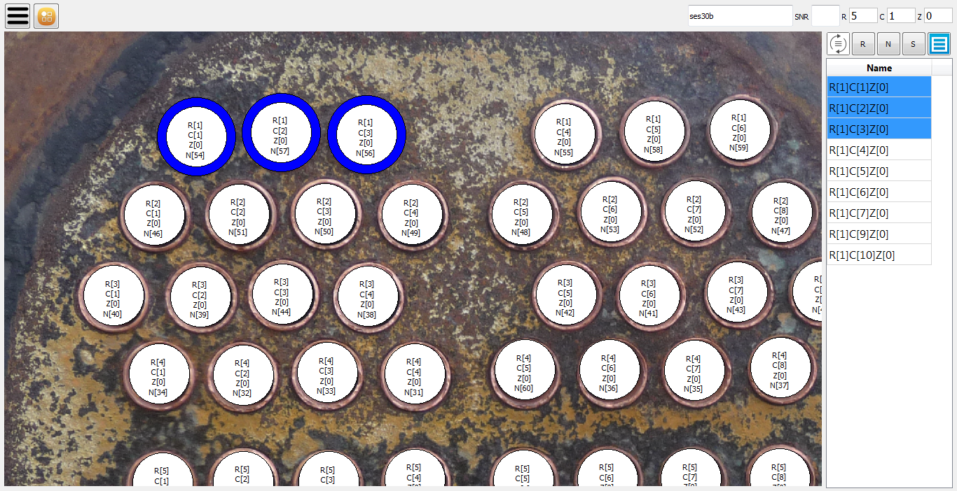
Map and Parameters Setup
Effortless map creation
Using photo, drawing or manually
Automatic tube selection and ordering
Parameters required
Length
OD diameter
Wall thickness
Ambient temperature

Slide 15
Data Collection and Upload
Hassle-free inspection
All information displayed on LCD
Easy navigation
Bad measurement warnings
Upload data for analysis using built in tools
Directly from the device via Wi-Fi
Using USB thumb drive and dedicated software

Slide 16
Report
Get the top quality final reports within max 24h
Analysis done by the most experienced analysts
Report designed according to industry standards

Slide 17
Package Contents
Protective backpack
Two battery sets
Charger
Adaptors (6mm-50mm)
Windows/Linux/Android software for easy setup

Slide 18
Industries
Oil & Gas (refineries, fuel processing)
Power generation utilities
Petrochemicals, chemicals
Food and beverage
Air conditioning (HVAC)
Pulp and paper
Tube cleaning QA

Slide 19
Standards
ASTM international approved standard ASTM E2906 / E2906M – 13
Standard Practice for Acoustic Pulse Reflectometry Examination of Tube Bundles
ASME standard
2015 Boiler & Pressure Vessel codebook article 18, book V (five)

Slide 20
Summary
Ultra-fast speed
Significantly faster than conventional inspection techniques
Less than 10 seconds per tube
Ease of use
Single operator inspection
Consistent, repeatable results
Battery operated
Mobility, whole system fits in a small backpack
Full coverage
Any shape (u-bends, “S” shape, twisted)
Any material (ferromagnetic, non-ferromagnetic)
Up to 50mm ID

Slide 21
Thank you
www.swis.ltd

